Slide 1
SoFI: Security Property-Driven Vulnerability Assessments of ICs Against Fault-Injection Attacks
Farimah Farahmandi
Electrical and Computer Engineering Department

Slide 2
Outline
Backgrounds
Critical Assets in SoCs
Fault Injection Techniques: Non-invasive, Semi-invasive, and Invasive
Fault Injection Countermeasures
Intrusion prevention: Sensors, Active shield, etc.
Fault detection: Redundancy, Error detection code, etc.
SoFI Framework
Security Property and Strobe File
Fault Model and Fault List
Critical and Feasible Fault
Evaluation on AES, RSA, and SHA
Conclusion and Future Work
Notes:
Fault Injection Attacks:
1. Fault-injection attacks have become a major concern for hardware designs, primarily due to their powerful capability in tampering with critical locations in a device to cause violation of its integrity, confidentiality, and availability. The fault-injection techniques include three categories: Non-invasive, Semi-invasive, and Invasive.
2. Two examples about performing fault-injection attack on SRAM cell and AES FSM
Fault Injection Countermeasures:
Researchers have proposed a number of physical and architectural countermeasures against fault-injection attacks, which mainly include two categories: intrusion prevention and fault detection.
SoFI Framework:
Inputs for the framework: netlist, stimulus, security properties (defined in strobe file)
Process: fault model characterization -> fault list generation -> fault simulation (using ZOIX) -> critical & feasible faults identification
Outputs: critical locations (exactly when and where to protect)
We did experiments on AES, RSA and SHA to evaluate how efficient the assessment flow is and how many critical locations to fault-injection attacks can be identified in the design. For each benchmark, its gate-level netlist as well as the corresponding security properties are considered for the evaluation of SoFI.
Finally, we conclude the SoFI framework and discuss about the future directions.

Slide 3
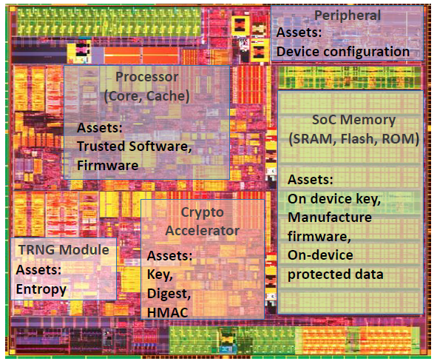
Critical Assets in SoCs
Asset: A resource of value worth protecting from an adversary
Examples:
On-device keys (crypto/obfuscation)
Device configuration
Manufacturer firmware
Random number or entropy
Application software
On-device sensitive data
Communication credentials
Source: Intel
Notes:
Before we go into different categories and examples about fault injection attacks, we might wonder why fault-injection attacks are important and what the adversaries are attempting to attack.
Firstly, what information or locations the adversaries are attempting to attack? Critical assets: A critical asset is any resource of value worth protecting from an adversary. On one single chip, there might be a lot of critical assets: on-device keys, device configurations, manufacturer firmware, etc.
A security asset can be either tangible or intangible, such as passwords or one’s fingerprint that defines the accessibility to a mobile phone. For integrated circuits, the asset could be encryption keys, obfuscation keys, device configurations, manufacture’s firmware, communication credentials, configuration bits, etc. These assets should be properly protected against various attacks to avoid any secret leakage, illegal authentication, loss of profit, or reputation decline.

Slide 4
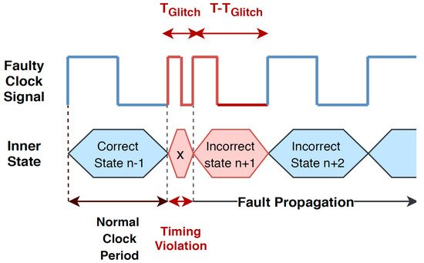
Rise of Fault Injection Attacks
Fault injection attacks
Errors are intentionally injected in a system to compromise the security of the design and facilitate the leakage of assets in the system
Taxonomy of Fault Injection Attacks:
Non-Invasive Attack
E.g., clock glitching, power glitching
Semi-Invasive Attack
E.g., focused light beam (laser), overheating by light
Invasive Attack
E.g., focused ion beam (FIB)
Kazemi Z, Hely D, Fazeli M, Beroulle V. A Review on Evaluation and Configuration of Fault Injection Attack Instruments to Design Attack Resistant MCU-Based IoT Applications. Electronics. 2020; 9(7):1153.
Notes:
1. With the emergence of the Internet of Things (IoTs) regime, promising exciting new applications from smart cities to connected autonomous vehicles, security and privacy have emerged as major design challenges. Within the connected computing and sensing components, or the things in an IoT system, notably the cryptographic hardware and field programmable gate arrays (FPGAs) in embedded systems, artificial intelligence (AI) accelerators, digital signal processors (DSPs), and microprocessors are all highly vulnerable to diverse forms of physical and non-physical attacks. These attacks can effectively bypass the security mechanisms built in these devices and put systems at risk.
2. Among all the attack approaches, fault-injection attacks have become a major concern because of their powerful capability in tampering with vulnerable locations in a device and ability for extracting its critical assets. In a fault-injection attack, the faults are intentionally injected in a system to compromise its security by causing the denial of service (DoS), achieving illegal authentication, or facilitating leakage of secrets in the system. Fault-injection attacks can be non-invasive (e.g., clock glitching or voltage glitching), semi-invasive (e.g., local heating or laser), or invasive (e.g., focused ion beam), which can be carried out by a variety of techniques and instruments with different cost and precision. Different forms of fault-injection attacks have been successfully demonstrated by researchers in academia as well as practitioners in the industry on many security-critical applications. Almost all platforms, such as smart cards, system-on-chips (SoCs), FPGA-based embedded systems, and IoT devices, are vulnerable to fault-injection attacks, which corroborates the criticality of this attack vector.
3. The figure shows an example of clock glitching causing an FSM jumping into faulty state during the execution.

Slide 5
Fault Injection Countermeasures
Intrusion Prevention
Make the device physically inaccessible
Detect the physical impact and tampering attempts in the design
Expensive with large overhead and design effort
Error Detection
Detect the injected digital faults
More cost-effective
Low coverage
Detection logic may be attacked
Notes:
The countermeasures evolve over time with the sophistication of fault-injection attacks. Since any countermeasure comes at a cost, in practice, they are selected with a good balance between overhead and security. In fact, many countermeasures are developed to make an attack sufficiently expensive for the attacker but not impossible. There are two major categories to protect a design against fault-injection attacks: intrusion detection and error detection.

Slide 6
Fault Injection Countermeasures
Fault Injection Attacks | Locations | Countermeasures
Clock Glitching | FFs | Spacial/temporal Redundancy
Voltage Glitching | FFs | Spacial/temporal Redundancy
Local Heating | Entire memory | ECC
EM Pulses | Entire memory | Metal shield, 3D-robust SRAM
EM Pulses | Memory cell | Rad. hardened SRAM design, ECC
EM Pulses | FFs | Spacial/temporal redundancy
Light Radiation | Entire memory | Metal shield, 3D-robust SRAM
Light Radiation | Memory cell | Rad. hardened SRAM design, ECC
Light Beam | Memory cell | Rad. hardened SRAM design, ECC, Intrusion detection/Watchdog
Light Beam | FFs, Gates | Spacial/temporal redundancy, Intrusion detection/Watchdog
Laser Beam | Memory cell | Spacial/temporal redundancy, Intrusion detection/Watchdog
Laser Beam | FFs, Gates | Spacial/temporal redundancy, Intrusion detection/Watchdog
Focused Ion Beam | Memory cell | Spacial/temporal randomization, Intrusion detection/Watchdog
Focused Ion Beam | FFs, Gates | Spacial/temporal randomization, Intrusion detection/Watchdog

Slide 7
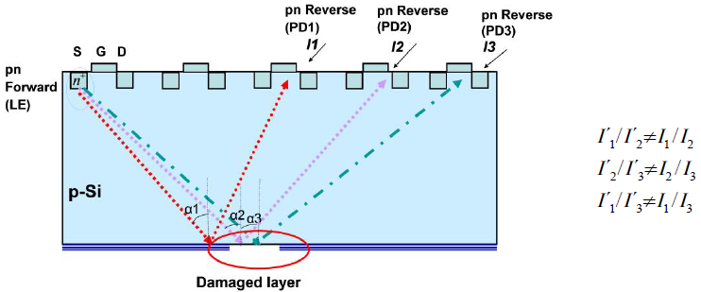
Example: Backside Tampering Detector
Elham Amini, Ruslan Muydinov, Bernd Szyszka, and Christian Boit. 2017 Backside Protection Structure for Security Sensitive ICs. In 43rd International Symposium for Testing and Failure Analysis (November 59, 2017). Asm.
One p-n junction is used as light source (LE) and several p-n junctions are used as receivers (PD) for detection.
As long as the ratio of the measured photocurrents confirms the angle dependence of the intact coating, the integrity of the coating has been verified
Notes:
In this example, the author investigated a patent that uses p-n junctions as light emitters (forward bias) and detectors. They improved the backside detection mechanism presented in the patent by developing a test structure and adding an optically active layer on the backside as a protective element to detect an attacked backside with electrical signals in the IC. The angle-dependent reflection provided by the layer acts as the protective function. They demonstrated how the light emission and detection concept is quantitatively working and how the active layer produces a backside layer integrity related signal in the IC which can act as attack indicator. The experiments also show that, due to the weak light emission intensity of silicon and the high excitation current, influences such as multi-angle reflection and stray current are reducing the angle-dependent effect on the signal and have to be taken into account in practical use.

Slide 8
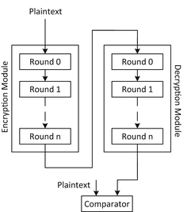
Example: Redundancy
Assumption: It’s very hard for attackers to duplicate the faults at the same time or location twice
Either hardware or time redundancy
Check the two results to see if there are faults injected
High overhead to be practical
Comparator could be attacked
Notes:
This approach modifies the design to allow the detection of injected faults at the algorithm level. One common method is concurrent error detection (CED), which can check the correctness of the algorithm by introducing redundancy. Typically, there are three types of redundancy in terms of resources: hardware, time, and information. As an example, hardware redundancy indicates adding extra hardware into the device to either detect or correct the impacts of the faults injected. The most common example is the triple modular redundant (TMR) structure which has three identical modules whose outputs are voted for correct functionality. Time redundancy can also be utilized to detect faults by re-running the same process on the same hardware. However, these approaches introduce at least 3X/2X area/performance overhead, respectively, which is too high to be practical for large-scale complex designs.

Slide 9
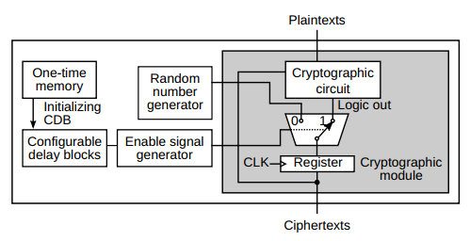
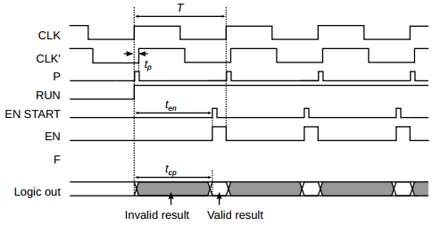
Example: CDB against Setup-time-violation [1] [2]
How setup-time-violation based attack be defended?
Avoid the bit-flips when there is a glitch
Hardened FF design
Hardened SRAM cell design
Gate sizing
Correct the bit-flip
EDC / ECC (only in memory)
Block the bit-flips from flowing to output
CDB-based enable signal generation
[1] S. Endo, Y. Li, N. Homma, K. Sakiyama, K. Ohta and T. Aoki, "An Efficient Countermeasure against Fault Sensitivity Analysis Using Configurable Delay Blocks," 2012 Workshop on Fault Diagnosis and Tolerance in Cryptography, Leuven, Belgium, 2012, pp. 95-102, doi: 10.1109/FDTC.2012.12.
[2] N. Selmane, S. Bhasin, S. Guilley, T. Graba and J. Danger, "WDDL is Protected against Setup Time Violation Attacks," 2009 Workshop on Fault Diagnosis and Tolerance in Cryptography (FDTC), Lusanne, Switzerland, 2009, pp. 73-83, doi: 10.1109/FDTC.2009.40.
Notes:
Countermeasures against setup-time-violation-based attack can be classified into three categories:
Avoid the bit-flip from happening: countermeasures are often making modifications on cell design or transistor size, thus, will make changes on the standard cell.
Correct the bit-flip after it is happened: EDC/ECC, normally applied on memories.
Block the bit-flip from flowing to the output: Even if a fault occurred in the circuit, attacker still need to observe the output, collect the incorrect results, and recover the key based on the faulty result analysis (e.g., DFA on AES).
This example added a Configurable Delay Block (CDB) based enable-signal generation module between the combinational parts and the flip-flop, the purpose is to block the faulty bits from flowing to the output.

Slide 10
Example: CDB against Setup-time-violation [1] [2]
Technique
Clock / voltage glitch can succeed on crypto core when its critical path is long enough
Add a mux and en-gen module, enable-signal is high only when the ciphertexts are available (e.g., done signal in AES)
Enable-signal-generation module must have longer path than comb. logic in crypto module
Enable-signal will miss the valid-result window when a setup-time-violation happens
CDB is necessary for enable-signal-generation module
Enable-signal should be accurately matched with the window when the results are available, in SoFI case, when the identified locations are vulnerable
[1] S. Endo, Y. Li, N. Homma, K. Sakiyama, K. Ohta and T. Aoki, "An Efficient Countermeasure against Fault Sensitivity Analysis Using Configurable Delay Blocks," 2012 Workshop on Fault Diagnosis and Tolerance in Cryptography, Leuven, Belgium, 2012, pp. 95-102, doi: 10.1109/FDTC.2012.12.
[2] N. Selmane, S. Bhasin, S. Guilley, T. Graba and J. Danger, "WDDL is Protected against Setup Time Violation Attacks," 2009 Workshop on Fault Diagnosis and Tolerance in Cryptography (FDTC), Lusanne, Switzerland, 2009, pp. 73-83, doi: 10.1109/FDTC.2009.40.
Notes:
CDB is necessary for this en-gen module because of process variation, we need to configure the enable signal rising time to match protected-results available window.

Slide 11
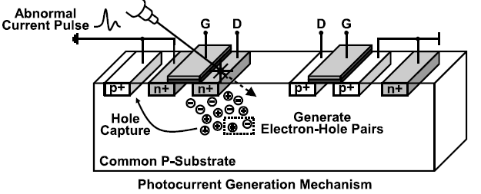
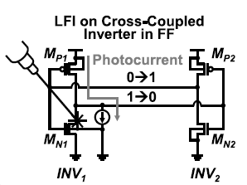
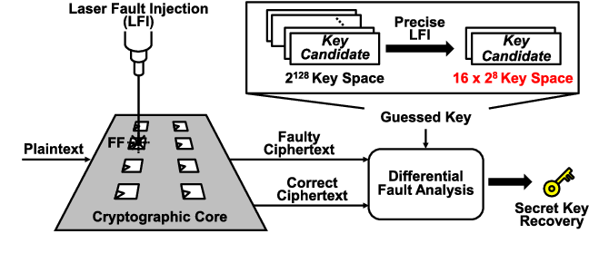
Motivation
Fault injection is a powerful attack to tamper the device and extract secrets
Current countermeasures, e.g., hardware/time redundancy, may involve 100% area or timing overhead
Lack of research in assessing the design’s vulnerability to fault-injection attacks at an early stage (gate-level)
No automated framework to perform such assessment
K. Matsuda et al., "A 286 F2/Cell Distributed Bulk-Current Sensor and Secure Flush Code Eraser Against Laser Fault Injection Attack on Cryptographic Processor," in IEEE Journal of Solid-State Circuits, vol. 53, no. 11, pp. 3174-3182, Nov. 2018
Notes:
Motivation for the SoFI framework
Currently, the countermeasures against fault-injection attack usually come with large overhead and design efforts making them difficult to use in practice. In addition, the current electronic design automation (EDA) tools are not fully equipped to support vulnerability assessment against fault-injection attacks at the design-time for secure hardware development. To perform a design-time (i.e., pre-silicon) evaluation of such attacks, a designer should be aware of various security vulnerabilities and must perform a tedious manual design review, which is time consuming and hard to ensure effectiveness. Therefore, it is very important to develop an automatic assessment framework to identify the most security-critical locations in a design to fault-injection attacks and place emphasis on protecting those locations.
If we can analyze the vulnerabilities in the design at an early stage, (determine the exact location and time for an attack to perform, which is ”executable security property”), we can involve much lower overhead to protect the design.
The figure shows that a precise LFI significantly reduced the key searching space and thus, the key can be recovered using DFA.

Slide 12
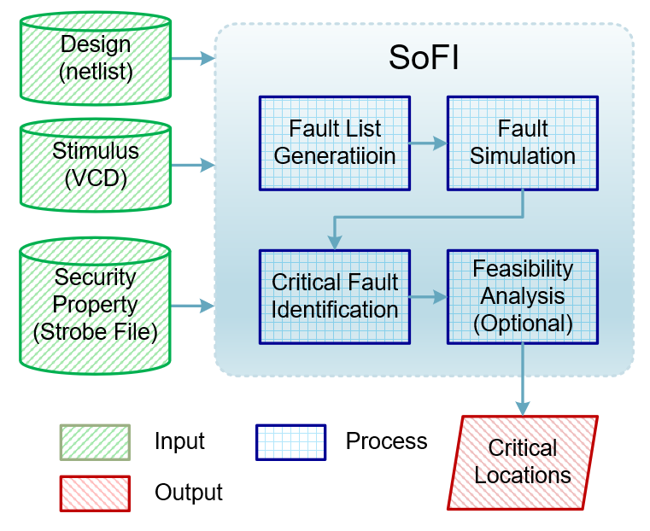
SoFI Framework
Assessment tool for ICs against fault injection attack at gate-level
Security property driven
Consider the capability of specific fault injection technique
Critical locations are identified
Provide opportunity for local countermeasures with low overhead
Notes:
Generally speaking, the critical locations to fault-injection attacks are identified by checking whether any security properties can be violated if the faults are injected at these locations. The more critical locations identified from the design, the more vulnerable the design is to fault-injection attacks. The SoFI framework takes fault-injection technique’s specification, executable security properties, and the gate-level design as the inputs. First, to map a specific fault-injection technique (e.g., clock glitch or laser) in the assessment, the fault models are characterized from the specification of the targeted fault-injection techniques and a fault list is generated based on the fault model and the executable security properties. Then, the fault simulation is performed and the critical locations are identified. Finally, the fault feasibility analysis is conducted to check whether the faults can be practically implemented by the specific fault-injection technique.
The term “fault simulation” here is different from that in ATPG tool. In ZOIX, it is basically running simulations continuously with faults injected in each simulation. Also, ZOIX will continuously check the strobe file to see if the injected fault is violating the security properties. Further details will be introduced later.

Slide 13
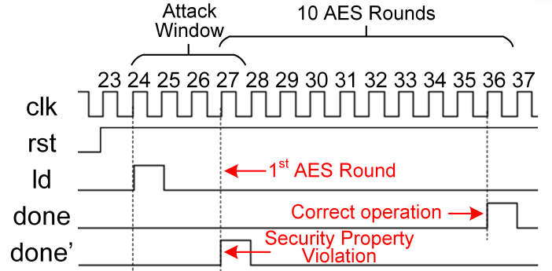
Security Property
Security property defines behaviors that must be present or must not be present in a design to maintain the integrity, confidentiality, and availability
Executable for SoFI
Should be related to or can be violated by one of the fault-injection attacks
Should be converted to executable formal presentations with explicit verification metrics
One example in AES controller (SP1)
The done signal that indicates the completion of 10 AES rounds cannot be raised in the 1st AES round.
Notes:
Slides starting from this are introducing all the conditions / files that SoFI needs
As mentioned, a security asset in a chip is a value that is worth protecting against different adversaries. These assets should be properly protected against various attacks to avoid any secret leakage, illegal authentication, loss of profit, or reputation decline. Therefore, we need corresponding security properties (SP) specifying the secure utilization of the design as a guidance to protect these assets and improve the scalability of the proposed SoFI framework. Further, by tampering security-critical locations using fault-injection techniques, the attacker can violate the security properties and achieve privileges to leak/tamper asset information. Hence, the capability to violate one of the security properties can be utilized as the criteria to identify the critical locations. If the injected faults cannot violate any of the security properties, the underlying threat is much less of a concern compared to the faults that can violate properties. This can help with prioritizing the critical faults and locations, and to develop effective and resource-constrained local countermeasures.
As an input to SoFI, the appropriate selection of security properties dictates the quality of the assessment because not all security properties are suitable for fault-injection vulnerability assessment. For example, the security property described in, “exposed area to probing attacks should be lower than a threshold value”, is a good security property to mitigate the threat from probing attacks at the layout level. However, it is not suitable for our fault-injection vulnerability assessment since this security property cannot be violated by faultinjection attacks; further, this property is at layout level instead of the gate level. Therefore, one requirement for identifying the security property subset in this work is that the security property should be related to or can be violated by one of the fault-injection attacks. In addition, most of the security properties available in the literature [32], [33] are described at a high level (often using natural language) without detailed metrics. It may not be clear how to check if the security property is violated in the target level of abstraction of the design. Therefore, the second requirement for the security property in this work is that the security property should be converted to one or more executable formal presentations with explicit verification metrics.

Slide 14
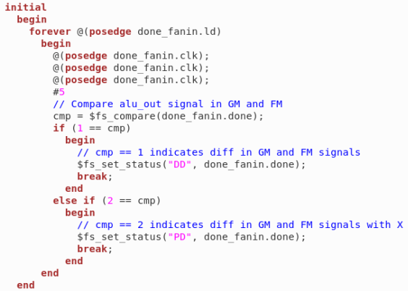
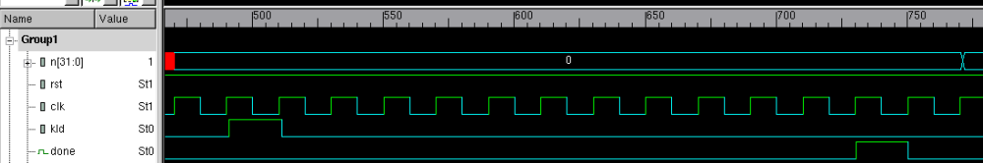
Strobe File
Security Property (SP)
Are checked in the fault simulation using strobe file
Strobe File
Written in System Verilog
When, Where, and What to check for security property violation
If diff in GM and FM, SP violation
When: 3 clock cycles after ‘load’ is raised
Where: at signal ‘done’
What: compare the signals
in GM and FM
Strobe Here
0 1 2 3 4 5 6 7 8 9 10 11 12
Notes:
Strobe file contains all the definitions of executable security properties needed by SoFI.
GM: good machine
FM: faulty machine
In this example, SP violation checking will happen 3 cycles after “load” is raised. If violated, this fault will be labeled as “DD” status (Drop Detected). Other status include “Not Detected” “Potentially Detected”, etc.
This whole process will be executed for each of the faults in fault list.

Slide 15
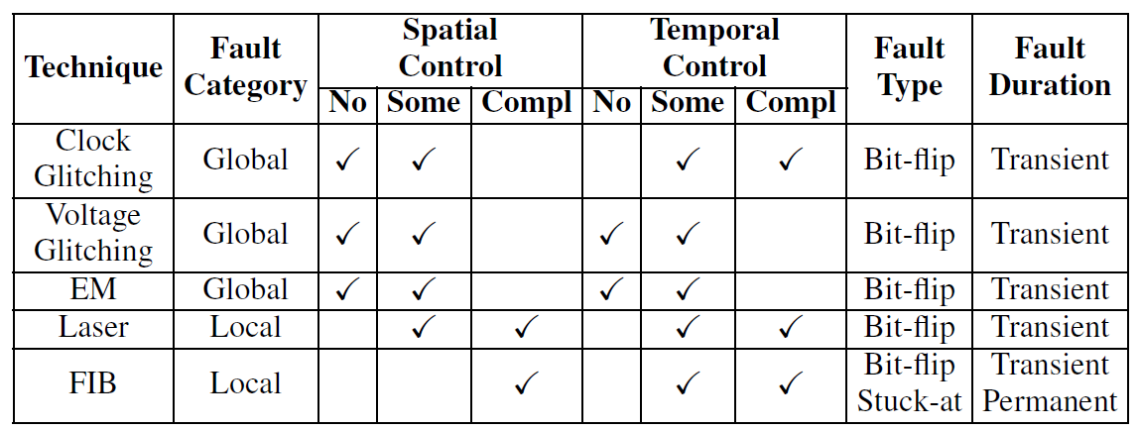
Fault Model
Fault Category
Global fault and Local fault
Fault-injection Location
Complete control, Some control, and No control
Fault-injection Time
Complete control, Some control, and No control
Fault Type
Stuck-at fault, Bit-flip fault, Set/reset fault, and Destructive fault
Fault Duration
Transient and Permanent
Notes:
There are many techniques to inject faults in a system, such as clock/voltage glitching, EM, laser beam, or FIB. The mechanism of fault generation from these techniques are fundamentally different. Hence, the format and impact of the faults injected by these techniques also differ significantly. For example, the faults injected by clock glitching may be global and random, while the faults injected by laser may be local and deterministic. Therefore, a comprehensive modeling of the existing fault-injection techniques is necessary to enable fast, reliable, and accurate assessment of the fault-injection vulnerability. Without such models, it is difficult to evaluate how these faults injected by different techniques would impact the circuit and security properties.
A fault model is a set of attributes characterized from the physical impact of the faults injected by a specific technique. It converts a physical event of fault injection into a logical model. Using the logical model, we can simulate the fault injection and propagation in the digital circuit and analyze the impact of the faults for different fault injection techniques. Different fault-injection techniques differ greatly in their ability to control the location and time (spatial and temporal) of the injected faults, in the number of bits affected, etc.
This slide shows fundamental attributes for our proposed fault model characterization.

Slide 16
Fault List Generation
Global Faults
Injected by the techniques with no/less control of the fault location, e.g., clock glitching or voltage glitching
Model: transient bit-flip fault in FFs for one clock cycle
Local Faults
Injected by the techniques with some/complete control of the fault location, e.g., laser or EM
Model: transient bit-flip fault in any cells for one clock cycle
Number of concurrent fault locations
Small design: all possible combinations of target cells
Large design: only consider at most 2 concurrent fault locations
The possibility to inject faults at specific multiple locations to violate security property is quite small
Limited by the number of beam sources
Notes:
To implement the fault simulation, a detailed fault list must be generated with the exact time, location, type, and duration of the faults. The fault list is generated based on each security property and fault model. For most fault-injection techniques, the fault type can be modeled as bit-flip and the fault duration can be modeled as transient for one clock cycle
Fault list (in .sff format) is also a needed input file for ZOIX fault simulation. This slide includes the assumptions we made for global & local faults to generate the fault lists. For large design, we only considered at most 2 concurrent fault locations

Slide 17
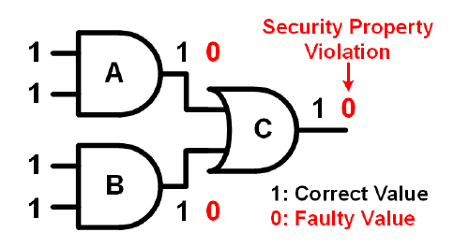
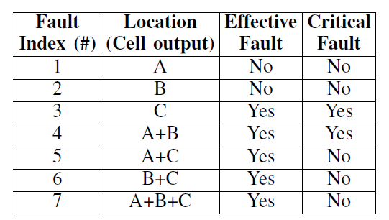
Critical Faults
Effective Faults
Faults that can violate the security property
Critical Faults
Faults where all fault locations are contributing to the security property violation
In the example
7 faults in total, 5 effective faults, but only 2 critical faults
Notes:
After performed fault simulation by ZOIX, it will list all the detected faults that are violating the SPs. But we need to further identify the critical ones in the results. Because:
For the example in this form, C is a critical fault because any fault-combinations including C will cause a SP violation, so we can avoid all this kind of violations by only protecting C locations.
Detailed example:
When the fault simulation is done, we would know whether a fault in the fault list is effective at violating the target security property. One fault can consist of one or more fault locations. As an example shown in Fig. 5, its fault list is shown in Table IV. As we can see, faults #1-3 only have one fault location, while faults #4-6 have two fault locations and fault #7 has three fault locations. If an effective fault consists of two or more fault locations, not every fault location is necessarily contributing to the security property violation. In other words, injecting faults at a subset of the fault locations of an effective fault may still violate the security property. Therefore, faults with all fault locations contributing to the security property violation are defined as critical faults. For the example shown in Fig. 5, we consider that the following security property: the output of cell C should not be 0. Also, assume that faults can be injected at any combination of the output of cells A, B, and C. Table IV shows the fault list and the identified critical faults in this case. Three possible fault locations (cell output: A, B, and C) result in 7 different faults considering all combinations of the three fault locations (P3 i=1 3i). Except for faults #1 and #2, all other faults can effectively violate the security property. However, one can see that some fault locations are not critical to the property violation. For example, a single location fault at cell C (fault #3) alone can violate the security property. It is the critical contributor to the violation, so this fault is identified as a critical fault. Any other fault that contains the fault location at cell C (e.g., fault #5-#7) can violate the security property because of the existence of the fault at cell C, instead of the faults at other fault locations. They are effective faults but not critical faults. Another critical fault identified in this case is the fault at location A+B (fault #4: concurrent fault at A and B). Although there are 5 effective faults in this example, only 2 can be identified as critical faults.

Slide 18
Fault feasibility
Not every critical fault can be implemented
Need to consider the capability of a specific fault injection technique
Fault Feasibility Analysis
For setup time violation based fault injection techniques, e.g., clock or voltage glitching
Faults can only be injected at switching edges
Infeasible via Clock glitching
Notes:
In the fault simulation, each fault can be injected precisely at the desired location and time. However, in practice, even with the fault model characterization, not every fault in the fault list can be executed corresponding to its model on physical devices by the specific fault-injection technique since different techniques may have different requirements and limitations on where and when the fault can be injected. Therefore, we perform the fault feasibility analysis for specific fault-injection techniques, so that the critical faults and critical locations identified from the previous step make sense in a practical attack.
This step is optional in SoFI framework but helpful. E.g., for those faults that can only be injected at switching edges, even if some of them are identified as critical faults, they still may be infeasible under some FSM encoding schemes / state transitions.
Feasibility Analysis of Setup-time Based Fault-Injection Techniques: Many fault-injection techniques, such as clock glitching or voltage depletion, are leveraging the setup-time violation of flip-flops to inject faults. Clock glitching reduces the clock period and the voltage depletion extends the path delay so that the setup time constraint of the flip-flops can be violated in both scenarios. However, the setup time violation cannot guarantee a bit-flip fault to be injected into the design. Essentially, when the setup time is violated, the flip-flop will latch the value of the previous clock cycle. If the value of the current clock cycle in normal operation is consistent with the previous cycle, the flip-flop will still latch the correct value even if the setup time is violated. Therefore, the bit-flip fault can only be injected in flip-flops when a state transition is expected in normal operation.
Design Suggestions against Local Fault-injection Techniques: For those local fault-injection techniques, such as laser or FIB, the faults feasibility depends on the physical implementation of the design, such as place and route. One limitation of these local fault-injection techniques is the number of laser beams/focused ion beams. Typically, there is only one laser beam available for fault-injection. Hence, if a critical fault requires two or more concurrent fault locations, e.g., cell A and cell B, by placing cell A and cell B with a far enough distance that larger than the maximum spot size of the laser, this critical fault would never occur by the laser. Such design suggestions can be made in our assessment framework, so that all critical faults with two or more locations would never be implemented using the laser with only one beam.

Slide 19
Evaluation on AES, RSA, and SHA
Security Properties in FSMs
SP2.1: In the FSM of AES controller, Initial Round state cannot directly jump to Final Round state without going through Do Round state.
SP2.2: In the FSM of RSA controller, Square and Multiply states cannot be bypassed to Result state.
SP2.3.1: In the FSM of SHA controller, each time when a block is loaded, the Data Input state should not be bypassed.
SP2.3.2: In the FSM of SHA controller, when the last block is loaded, the Block Process and/or Block Next state should not be bypassed.
Security Properties against DFA
SP3.1: At the 9th round of AES, any 1-3 bytes of the first word in the round key cannot be faulty and the faulty bytes cannot propagate to the following words in the same round.
SP3.2: At the 9th round of AES, 4 bytes of any word in the round key cannot be faulty and the faulty bytes cannot propagate to the following words in the same round.
A. Nahiyan, et al, “Security-aware fsm design flow for identifying and mitigating vulnerabilities to fault attacks,” IEEE Transactions on Computer-Aided Design of Integrated Circuits and Systems, vol. 38, no. 6, pp. 1003–1016, 2019
C. H. Kim and J.-J. Quisquater, “New differential fault analysis on aes key schedule: Two faults are enough,” in Smart Card Research and Advanced Applications, pp. 48– 60. Berlin, Heidelberg: Springer Berlin Heidelberg, 2008
Notes:
The last three slides introduced our experimental results. We determined executable security properties for AES controller, RSA controller, SHA controller and AES Key Scheduling module. Then we generated the fault lists and run simulations.
FSM
Many fault-injection attacks focus on analyzing the fault effects on data paths. However, finite state machines in the control path are also vulnerable to fault injection attacks. The security of an SoC can be compromised if the FSMs controlling the SoC are tampered by fault-injection attacks. Hence, the security properties to protect FSMs should be considered and the FSM’s vulnerability to fault-injection attacks should be assessed using SoFI. In this subsection, 4 security properties in the FSM of AES, RSA, and SHA controllers are evaluated, respectively.
DFA
Differential fault analysis (DFA) is one of the most well known fault-injection attacks to compromise the secret key of cryptography devices [1]. By injecting faults at a specific location and time during the encryption and comparing the faulty and correct ciphertext, clues of the secret key can be deduced. Hence, the key space can be significantly reduced to make brute force attack practical. Different DFA attacks may require different faults in terms of size, location, and time. If the required faults for DFA can never be satisfied, the attack would not succeed. In this subsection, the threat from three highly cited DFA attacks on the key schedule (KS) of AES are evaluated. The corresponding security properties are defined to protect the design against these DFA attacks.

Slide 20
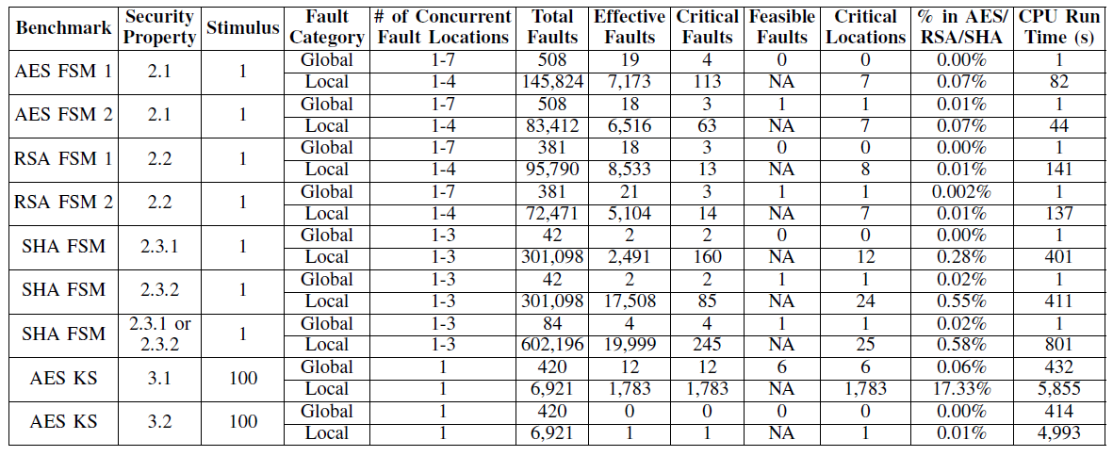
Fault Simulation Results
Inappropriate FSM encoding scheme can bring additional vulnerability (yellow)
FSM 1 and FSM 2 are using different FSM encoding
< 0.6% locations are identified as critical locations against fault-injection (green)
Except the local faults for SP3.1 (17.33%), since SP3.1 is too easy to violate
Notes:
Total faults: #faults in the fault list, all simulated by ZOIX
Effective faults: SP violated
Green column indicates the area ratio that the critical locations take. It will bring much lower overhead when we are only protecting these locations.

Slide 21
Conclusions and Future Works
Conclusions
SoFI: an automated framework for fault-injection vulnerability assessment at gate-level while targeting security properties
The fault models are characterized from different fault-injection techniques
Experimental results from AES, RSA, and SHA show that by protecting less than 0.6% critical locations in the design, the threat from fault-injection attacks can be significantly mitigated
Future Works
Expand the SoFI framework to the RTL and physical level
Apply SoFI to larger SoC benchmarks with more security properties
Develop more comprehensive fault models
Develop efficient local countermeasures to protect the identified critical locations
Automate the security property mapping process
Notes:
In this paper, for the first time to our knowledge, we bridge the gap between the need for automated security assessment tools against fault injection attacks and the capability of existing computer-aided design (CAD) tools commonly utilized by chip designers. We develop an automated framework for fault injection vulnerability assessment at gate-level while targeting security properties using novel models and metrics. The fault models are characterized from specific fault-injection techniques and the fault simulation is performed with security properties taken into consideration so that the critical locations to fault-injection attacks are identified. Our experimental results from AES, RSA, and SHA show that for most security properties considered in the paper, by protecting less than 0.6% critical locations in the design, the threat from fault-injection attacks can be significantly mitigated. In the future, we plan to expand the SoFI framework to the RTL level as well as the physical level and apply SoFI to larger SoC benchmarks with more security properties. In addition, local countermeasures, such as hardware, time, or information redundancy-based techniques, will be developed to protect the identified critical locations more efficiently with lower overhead.

